Slide 1
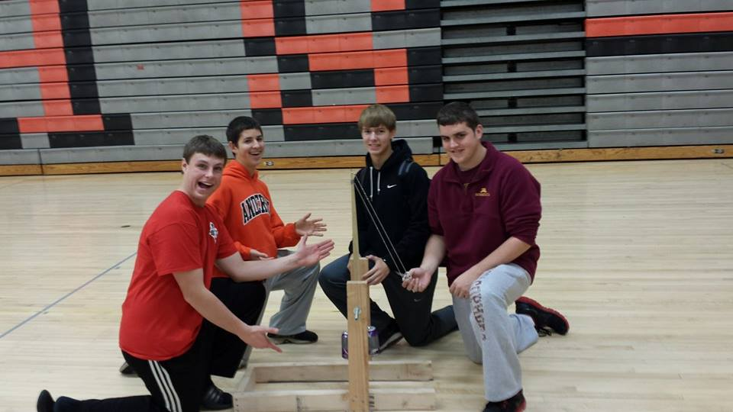
Terry the Trebuchet

Slide 2
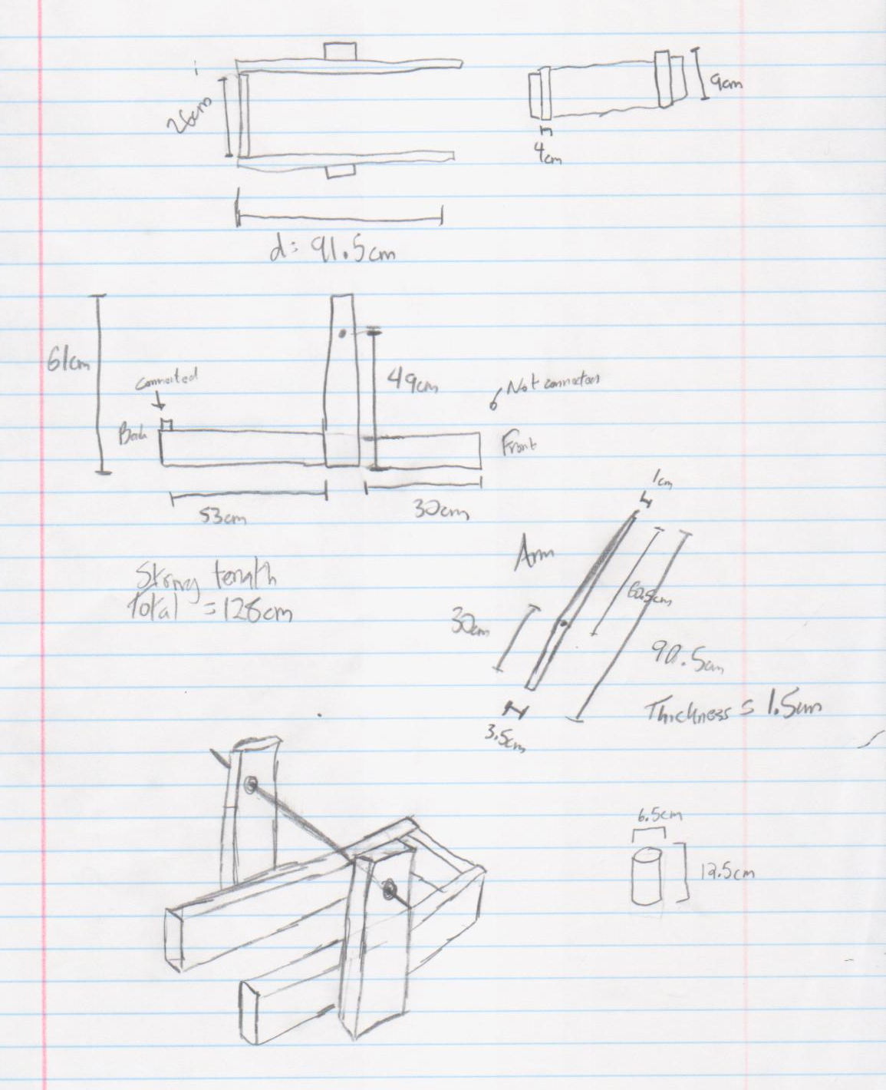
Original design blueprints

Slide 3
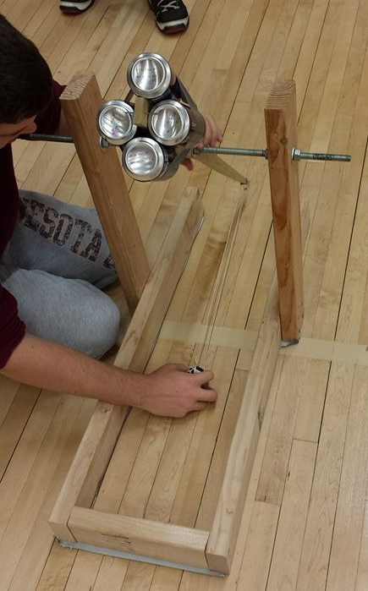
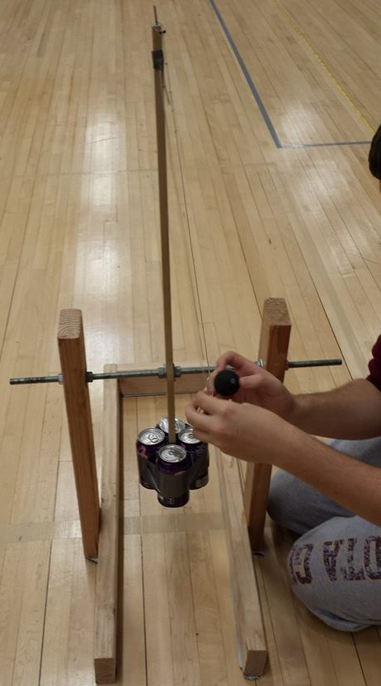
Loading the Trebuchet
Pulling back the Trebuchet

Slide 4
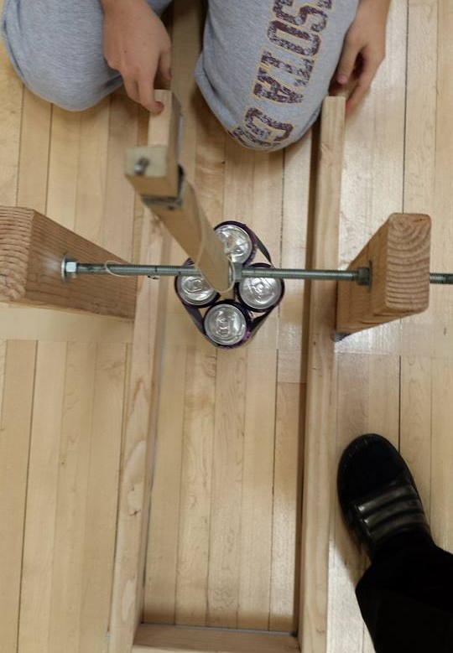
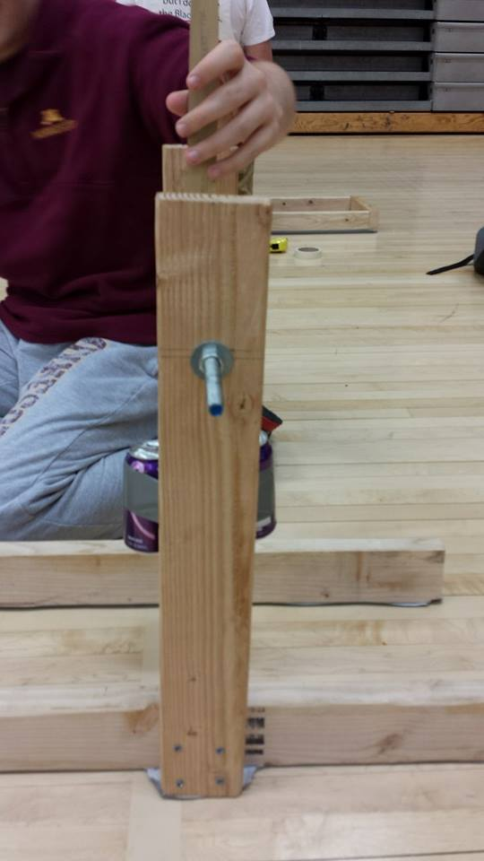

Slide 5
Videos of Trebuchet in Action
https://www.facebook.com/photo.php?v=773191456028929&l=3679807862237311506
https://www.facebook.com/photo.php?v=774710645877010&l=4279277212016933596
https://www.facebook.com/photo.php?v=774711245876950&l=4825069819474722169

