Slide 1
CO2 Dragster Car
By: Bill Pahutski and Luke Fickenworth

Slide 2
UNderstand
We were required to build a wooden dragster car that was to be powered by Carbon Dioxide.
The CO2 cartridge would be inserted into a small hole in the back of the car. After being punctured, this would send the car shooting forward.
Sample CO2 Dragster Car

Slide 3
Explore
To make a car that could win the competition, we had to do some research.
We discovered that the more aerodynamic our car, the faster it would be.

Slide 4
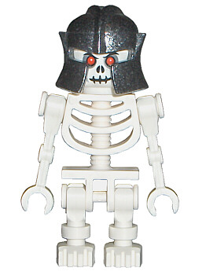
Explore
After some consideration, we decided we’d rather design a car that looked cool, rather than one that could win the race.
So we settled on a design with a sharp point at the front and room for a Lego skeleton to ride in it.

Slide 5
Define
We got requirements that our car design had to meet.
Some of these included a maximum and minimum for weight, maximum and minimum for length, as well as axle perimeters.
We made sure to follow all of these as we designed and eventually created our CO2 dragster car.

Slide 6
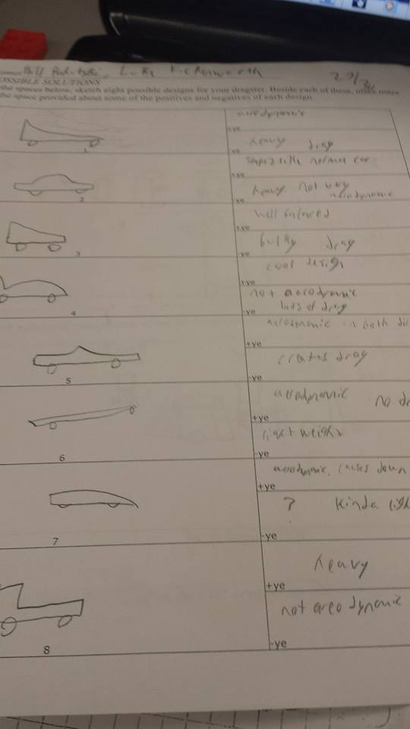
Ideate
We planned our design by sketching out several possibilities first.

Slide 7
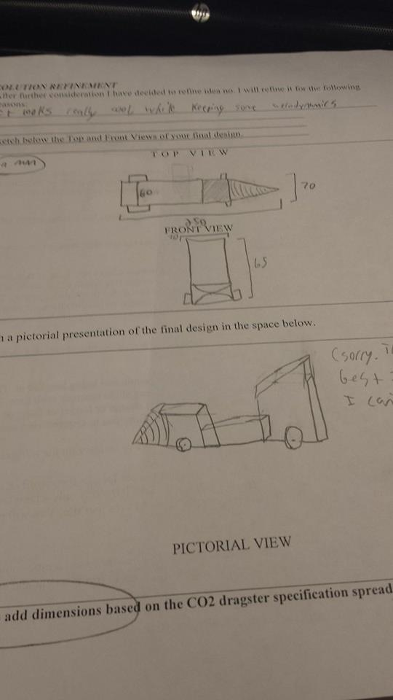
Ideate
We narrowed our designs down one design that we really liked.

Slide 8
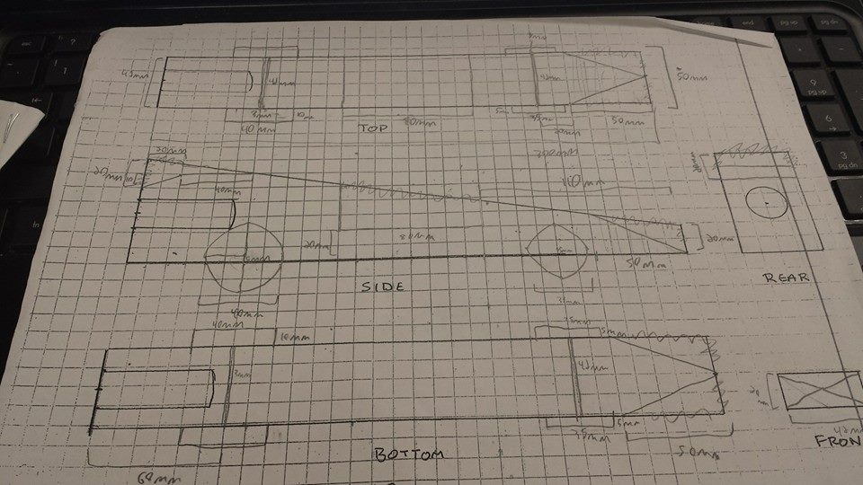
Ideate
We sketched out all the parameters before creating it on Inventor Studio

Slide 9
Prototype
First, We designed our CO2 car on Autodesk Inventer. We gave it the specification we had decided on in our ideate phase.

Slide 10
Prototype

Slide 11
Prototype

Slide 12
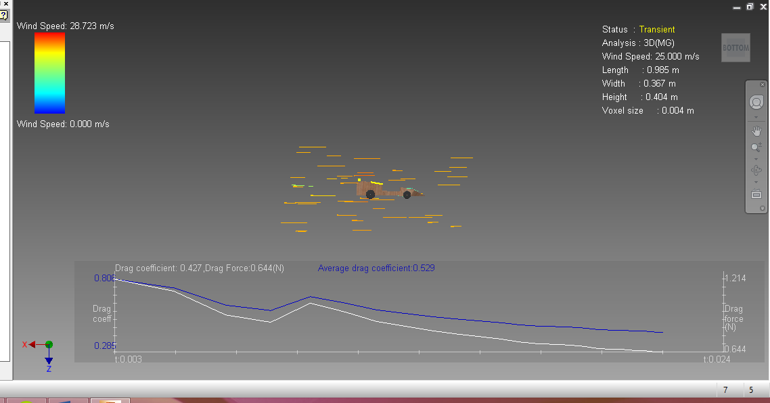
Prototype
We put our car into the inventor Wind Tunnel program to see how well it would perform.

Slide 13
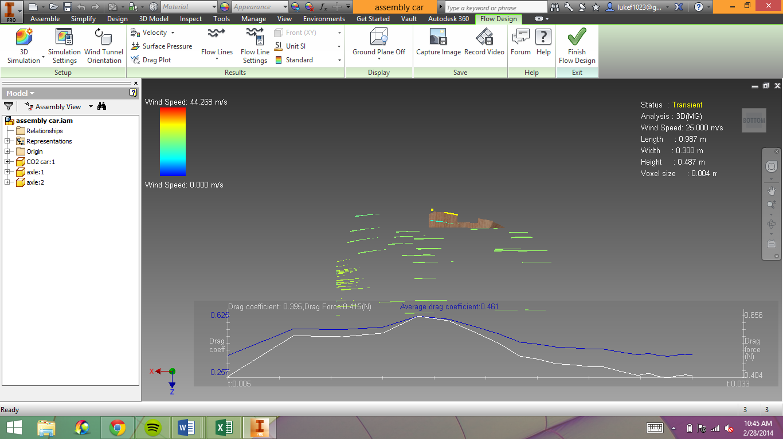
Prototype

Slide 14
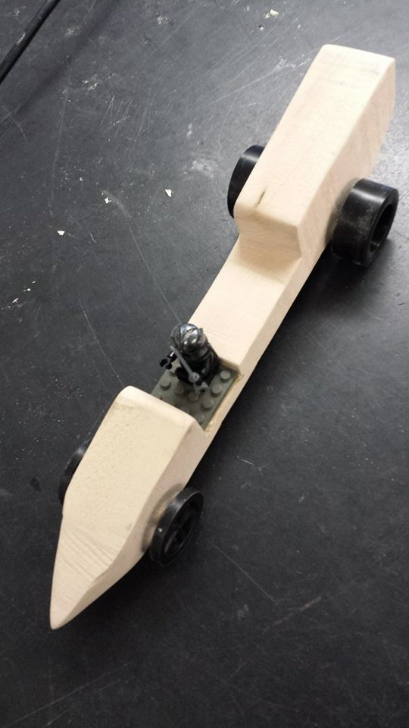
Refine
After adjusting our car to make it the most efficient, while keeping our design, we actually built it.

Slide 15
Solve
Our finished car:

Slide 16
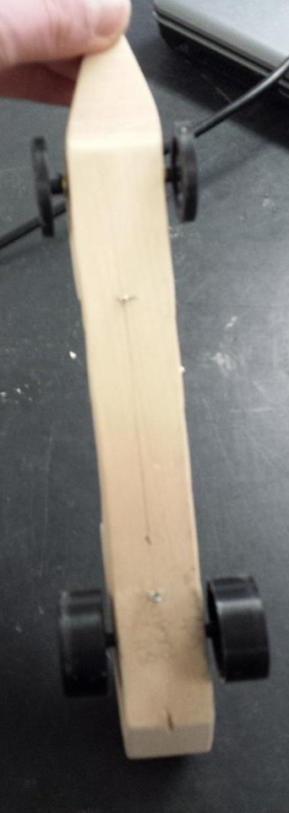
solve

Slide 17
Solve

Slide 18
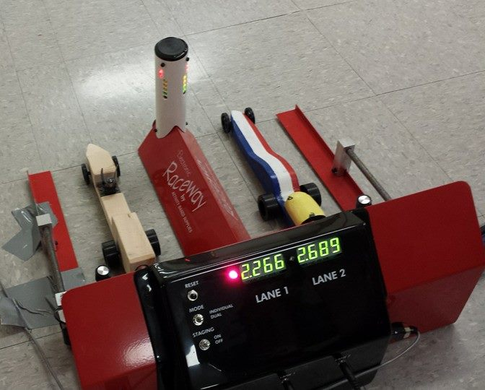
solve

Slide 19
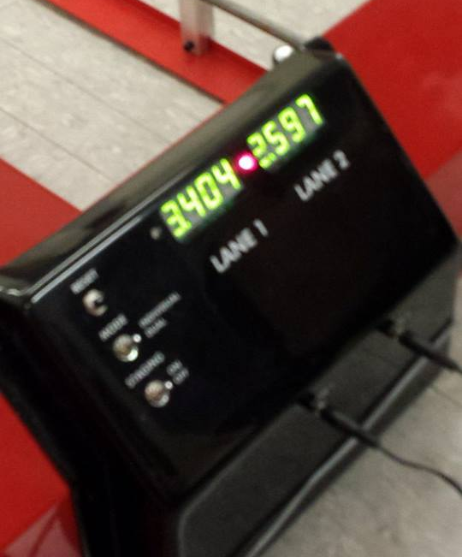
solve

