Slide 1
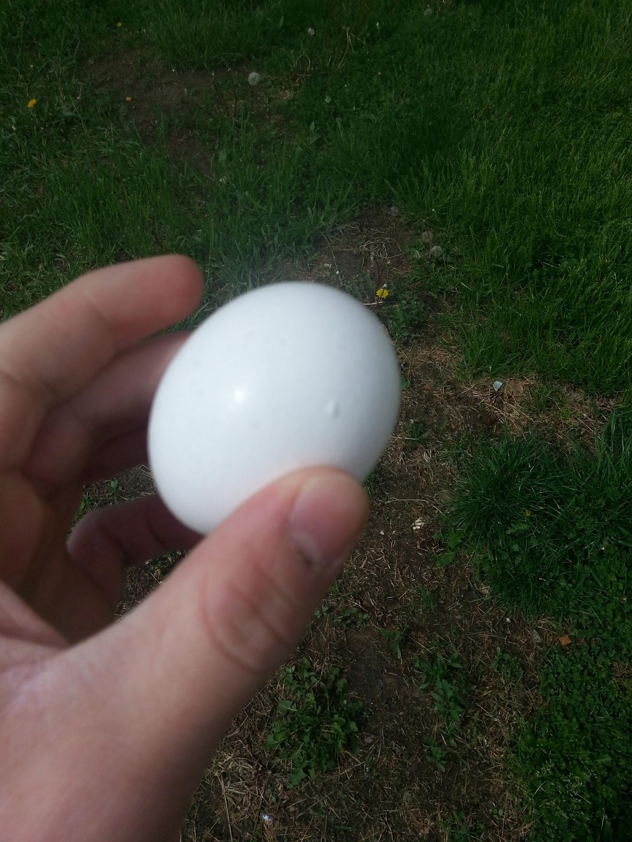
Egg Parachute
By: Luke Fickenworth and Sam Gravois

Slide 2
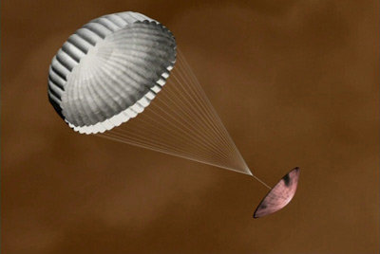
Understand
We were required to build a probe with a drogue and regular parachute that would prevent an egg from breaking on a 12 meter fall
The drogue parachute must come out first, and the egg cannot break or crack in any way
It was compared to a probe landing on the moon

Slide 3
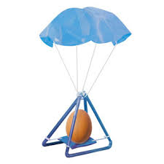
Explore
We researched some designs online, and discovered that we needed to supply a safe and secure place for egg for the trip down in the air
We determined that we did not want a very large probe, because that would increase our mass and require a larger parachute to slow the probe down

Slide 4
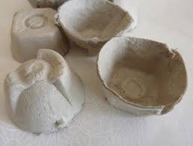
Explore
So we decided to make a probe made of a cardboard cylinder, which would minimize the mass, and in turn minimize the size of the parachute needed to slow down our probe so our egg would land safely
Inside our cylinder we put a part of an egg carton with the bottom cut off so our egg would sit comfortably inside our probe

Slide 5
Define
We looked at the requirments our probe and parachute had to meet
There was a maximum mass limit of 200 grams
We had to have two parachutes, a regular and a drogue parachute which had to be one fourth the surface area of the regular parachute
We used the equation to calculate terminal velocity

Slide 6
Ideate
- We used paper to make a funnel shaped container to hold the parachute
- The funnel was then taped to the probe
- Our parachute was cut out in a rectangular shape of a trash bag
- The parachute was connected to the funnel with string
- Lastly we made a smaller parachute to help pull out the main parachute from the funnel
- The smaller parachute was then tied to the larger one with fishing line
- The egg was suspended inside of the probe

Slide 7
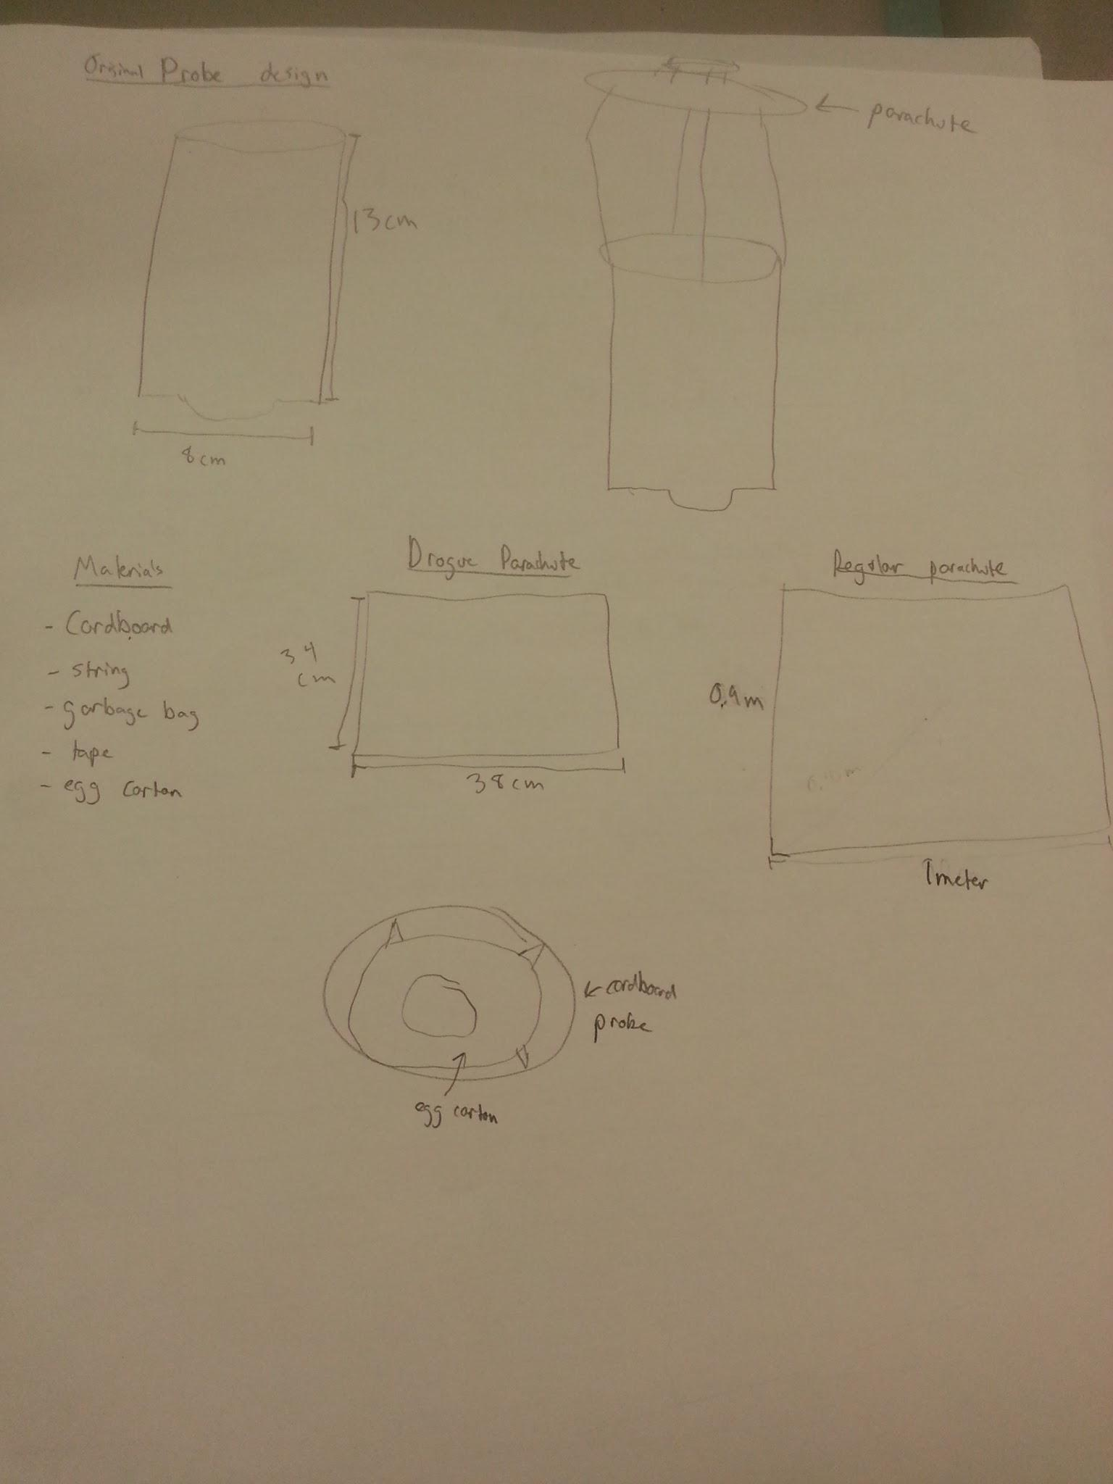
I
D
E
A
T
E

Slide 8
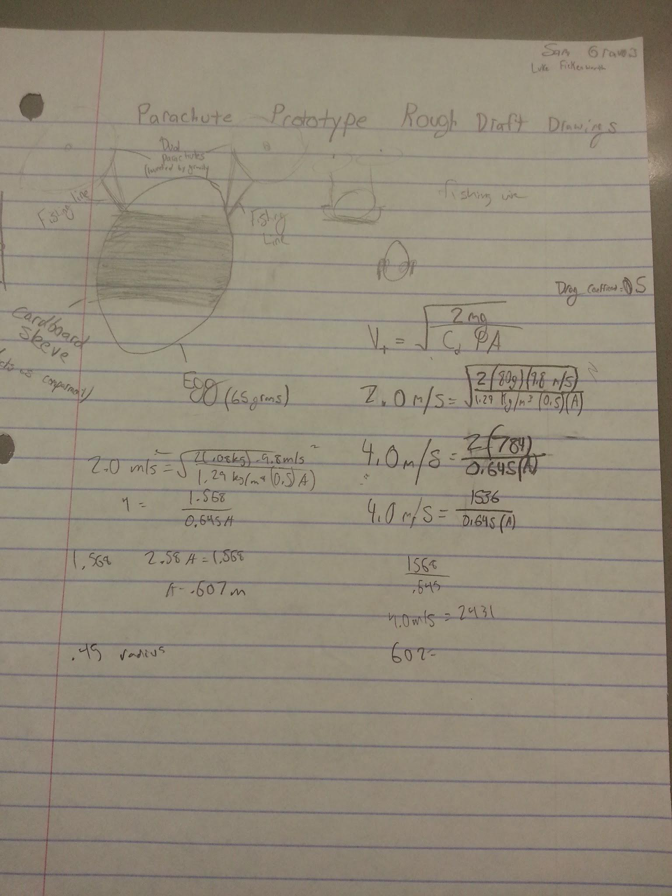
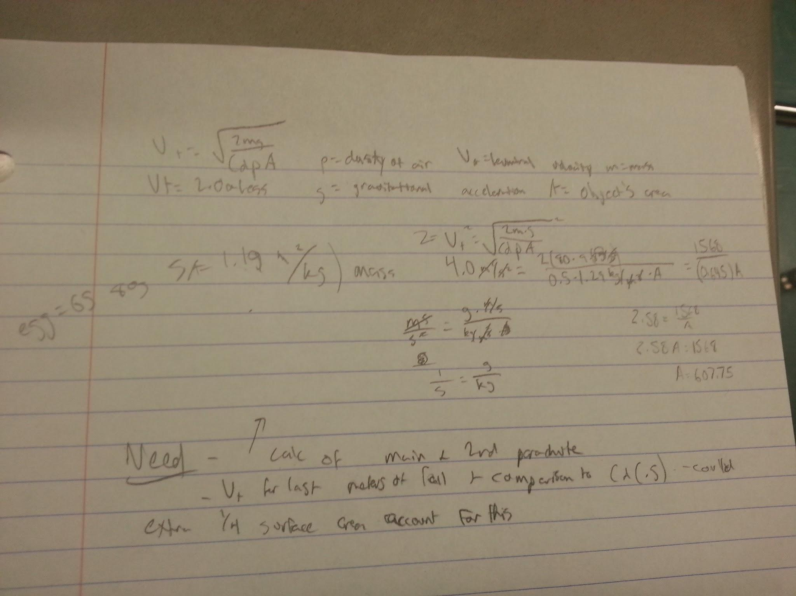
Ideate

Slide 9
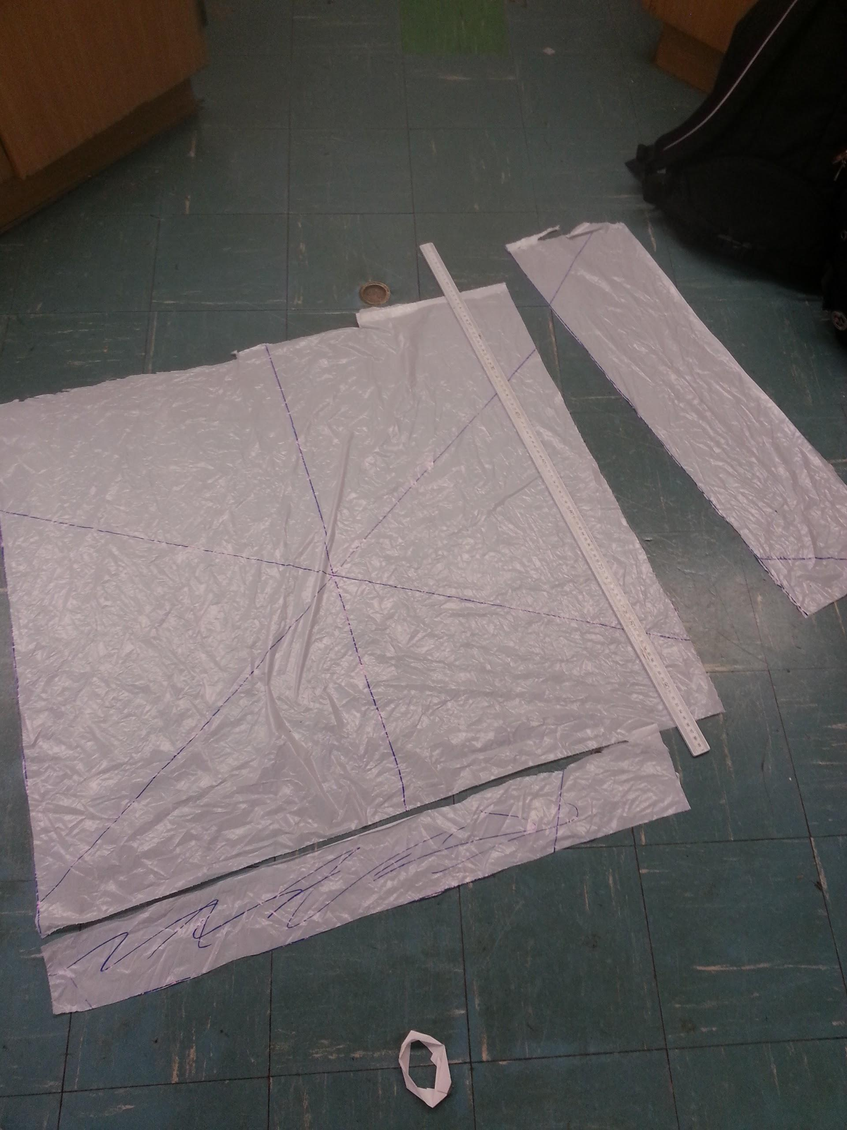
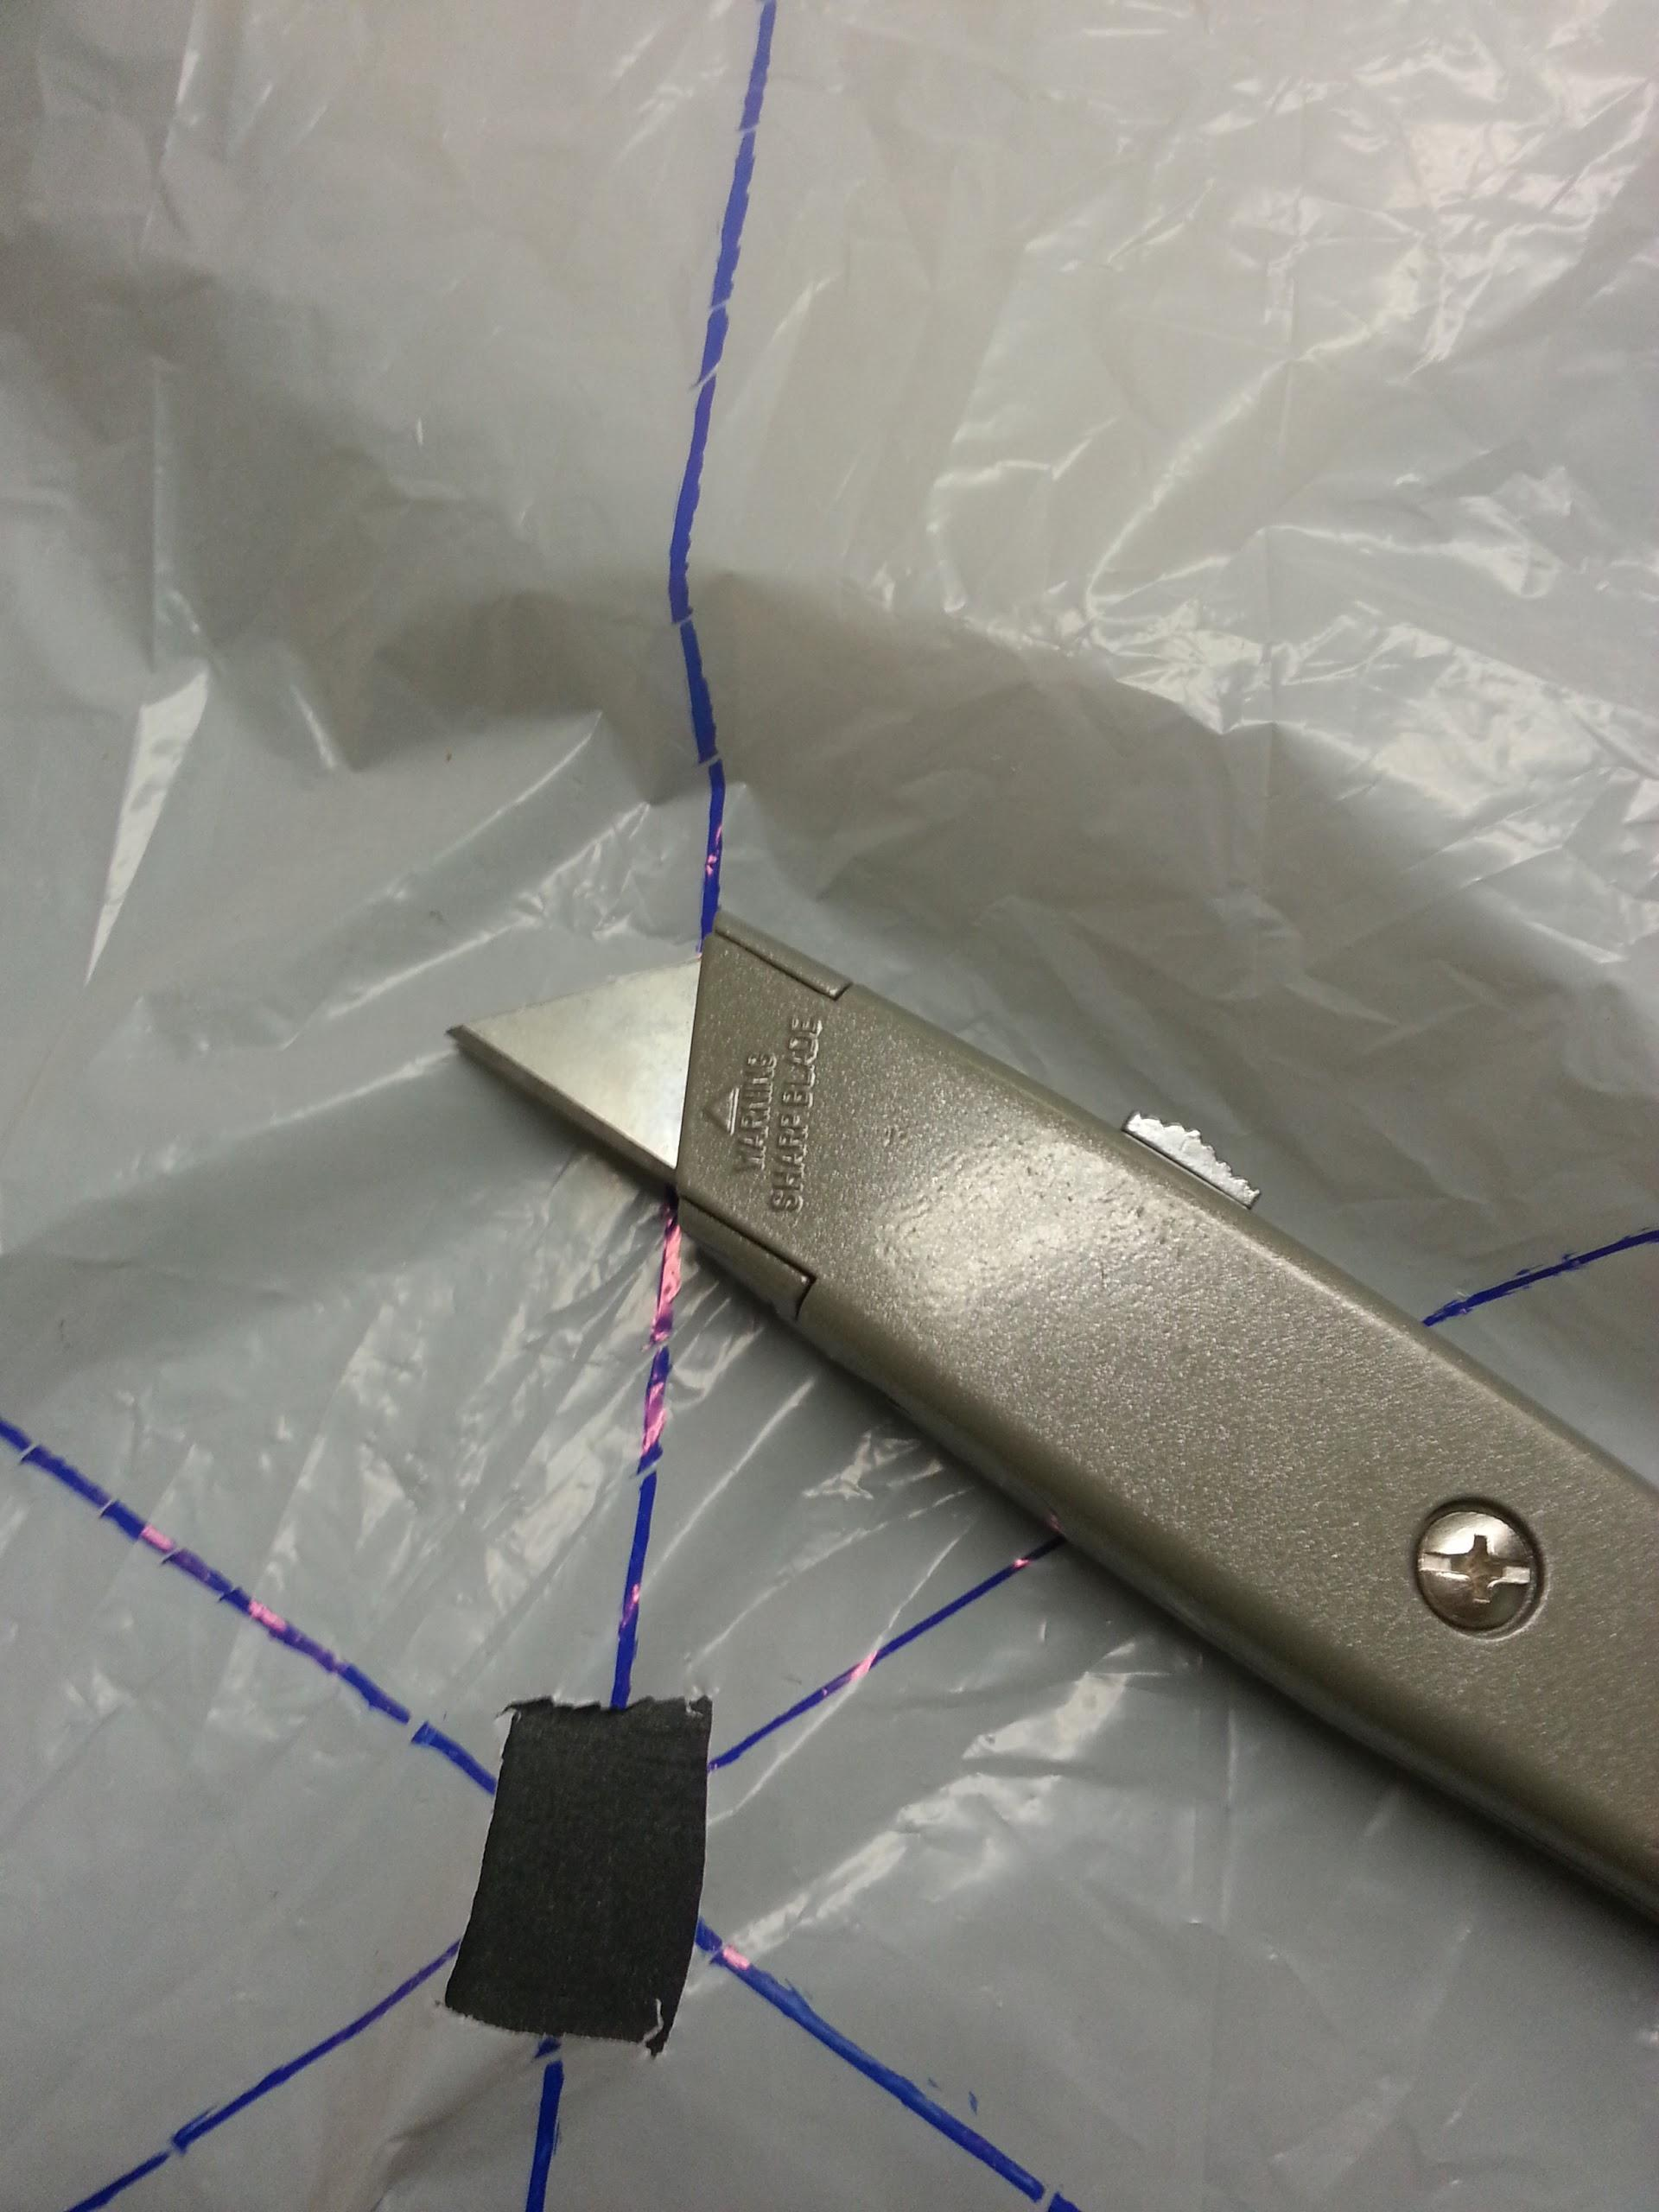
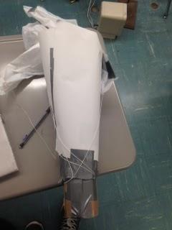
Prototype
- Now it came time to build our first model

Slide 10
Refine
- The funnel we used to pack the parachute into was too small
- The parachute was packed too tightly, and twisted up to let the other parachute pull it out
- This led to the big parachute not deploying out of the funnel
- We fixed this by replacing the funnel with a new, longer, wider one that would allow the parachute to be packed looser, and therefore pulled out easier
- The new funnel worked

Slide 11
Solution

Slide 12
Solution
Here is a link to our parachute in action:
https://www.facebook.com/photo.php?v=656825224370730&set=vb.100001297747120&type=2&theater&notif_t=video_processed

Slide 13
Solution
Our recorded times:
Drop # | Drop Height (m) | Drop Time (s) | Descent Rate distance(m)/time(s) | Surface Area of parachute (m^2) | Weight of System (N) | Theoretical Terminal Velocity (m/s)
1 | 3 | 1.43 s | 2.10 | 0.90 | 1.53 | 2.7
2 | 3 | 3.52 s | 0.85 | 0.90 | 1.53 | 1.92
3 | 3 | 3.75 s | 0.80 | 0.90 | 1.53 | 1.89

Slide 14
Solution
If I had to rate our project, I would rate it at a 7 out of 10. Our parachute was successful, but it took us longer than some of the other groups to get a working model. If i was to do this project again, I would make a much larger area for the parachute to go in before deployment, and maybe a slightly larger parachute.

