Slide 1
Nerf Gun
By: Luke Fickenworth and Grant Gallagher

Slide 2
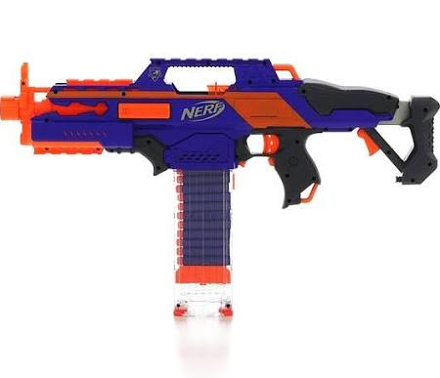
Understand
We were required to build a Nerf gun without using a majority of parts from a former Nerf Gun
The weapon could not be a modified Nerf gun

Slide 3
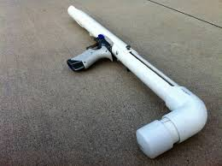
Explore
I researched ideas online for my Nerf gun and discovered there are multiple ways to make one
One way was compressed air, which required a tank and a release valve or plunger
Another way was just a self propelled gun, using air from my lungs to get the nerf dart traveling out of the tube

Slide 4
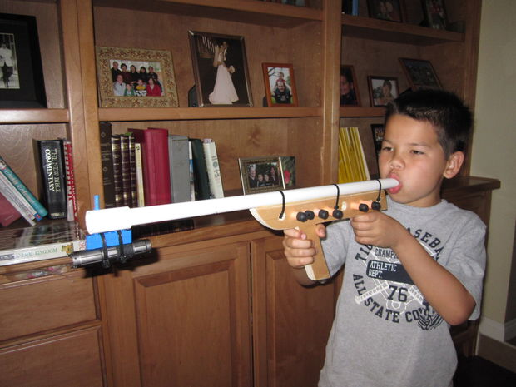
Explore
The compressed air idea would require a significant more amount of money to buy all the materials, and would also be more difficult to make
The simpler and cheaper idea would be a self-propelled gun, which would be easier to make and would most definitely be successful

Slide 5
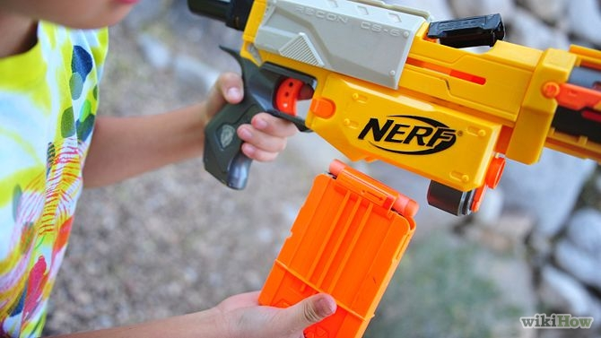
Define
To make our nerf gun we determined that it should be efficient, yet not costly or labor intensive
It could not be a majority of parts from a nerf gun or a modified nerf gun
The nerf gun should be able to fire more than one dart in rapid succession, through multiple barrels or a reloading system

Slide 6
Ideate
I sketched out a basic idea of what I wanted to do
I wanted an air container with a plunger that would thrust the air through the pipe and cause the dart to fly out of the gun

Slide 7
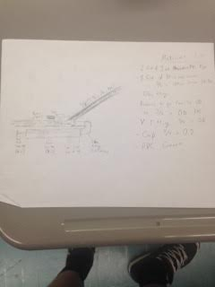
Ideate
Our detailed sketch for this idea
Along with a materials list
However, we decided that this gun
Was too expensive for what we wanted to spend

Slide 8
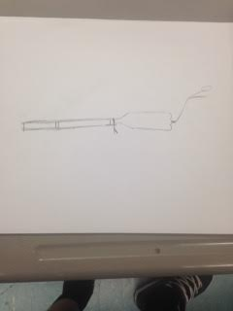
Ideate
Our next idea was a lot simpler yet we hoped just as effective
We wanted a two-liter bottle or some type of container to hold air attached to a pvc pipe, our barrel, with an air pressure valve to release the air to cause the dart to be fired

Slide 9
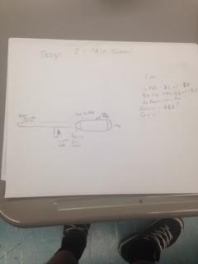
Ideate
The detailed drawing for our simpler idea
Along with the materials

Slide 10
Prototype
For our first prototype instead of a air release nozzle, we used a hose nozzle to control the air flow which attached easier to the container holding the air, and would be easier to shoot
Attached to the end of the hose nozzle was a piece of pvc pipe to act as our barrel

Slide 11
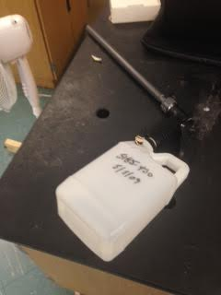
Prototype
Now it was time for our first model
We ran into some unforeseen problems with our air tank
It was leaking, and we could not find a thicker tank with the same fittings to attach to our barrel

Slide 12
Prototype
We attempted to limit the air leakage by using rubber bands where the air was leaking
It was leaking on the area from the tank into the hose nozzle
However this did not solve our problem

Slide 13
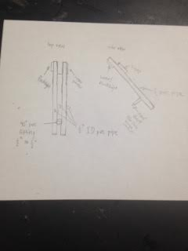
Refine
Because of money and material restraints, when our tank to our original idea did not work, we decided to change our idea and make a new gun

Slide 14
Refine
Our new idea was very simple, yet still would maintain the effectively from our previous idea
We took two pieces of pvc as our barrels, then out on smaller on in between with a handle attached to provide a place to hold our gun
Then we taped everything together, with the idea that our lungs would provide the air to fire the darts

Slide 15
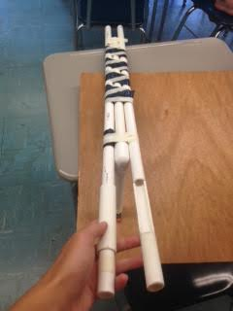
Refine

Slide 16
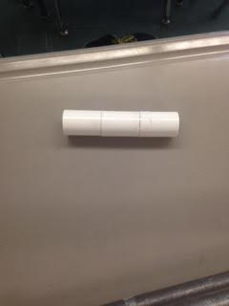
Refine
Slightly larger PVC
For a reloading mechanism on our new gun, we carved out a dart size spot on each barrel to slide a dart into after a dart was fired
Over the hole, we put a slightly larger piece of pvc pipe that was slideable along the barrel, so when we were ready to fire, air was not lost through the reloading hole

Slide 17
Refine
Also thinking about if we got into a short distance fight with someone, we put a dart on our handle to thrust at someone instead of wasting a dart on a short range shot

Slide 18
Solution
Trial | Distance | Wind | Time
1 | 55.6 feet | .94 mph | 3.1 seconds
2 | 53.4 feet | 1.21 mph | 2.9 seconds
3 | 52.2 feet | 1.47 mph | 2.8 seconds
Our darts we used were one gram with one strip of duct tape around the forward part to restrict wobbling. Our reload speed time was

Slide 19
Solution
Our original plan did not go as we had hoped, yet we recovered and made a formidable gun that was very effective in its accuracy and reloading

Slide 20
Solution
Video of our gun firing: https://www.facebook.com/photo.php?v=668820413171211&set=vb.100001297747120&type=2&theater
Reloading mechanism: https://www.facebook.com/photo.php?v=668820166504569&set=vb.100001297747120&type=2&theater

