Slide 1
IPhone 5 Case
By: Luke Fickenworth and Grant Gallagher

Slide 2
Understand
Design an innovative smartphone accessory that fits the needs/wants of a particular person using inventor
Person we are creating a case for loses their credit cards, drivers license, and money a lot
Need to keep it all together with their phone, because they do not lose their phone- Busy parent or businessman

Slide 3
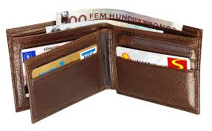
Explore
Knew we wanted to combine wallet into a phone case
Looked at various wallets online, noticed common theme of slits for credit cards, drivers licenses, and cash money
Thought of idea to put Velcro strip on case attaching polyester material to a basic case for easy access

Slide 4
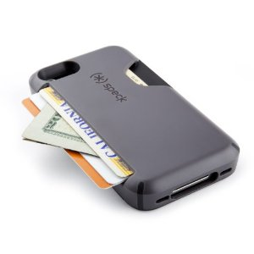
Explore (cont.)
We noticed there are other similar products on the market, such as this case by the company speck

Slide 5
Define
Problem: person loses credit cards, drivers license, and money a lot and cannot find them
Solution: combine and put those things into the phone, so you only have one thing to carry around and not lose
Considerations:
Need easy access
Large enough to store all materials
Durable and sturdy case
Appeal to popular demand- modern, colorful look
Affordable to public

Slide 6
Ideate
Our first idea was to attach the back of the case with hinges on the side so the case could have easy access but have space for the items the customer wants to put in
But it needs to look attractive to the public eye and be affordable, preferably less than fifteen dollars, and no more than twenty dollars
We also had the idea of putting a Velcro strap along the top on the back of the phone with a flexible material attaching to the case, for easy access in and out.

Slide 7
Ideate

Slide 8
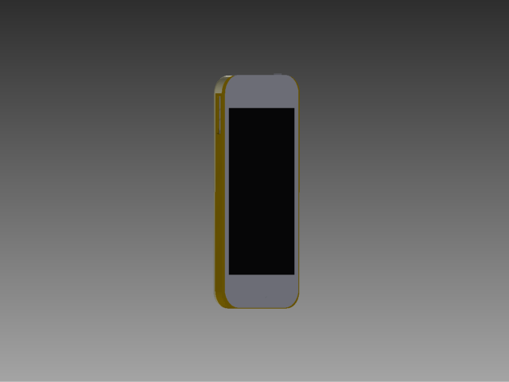
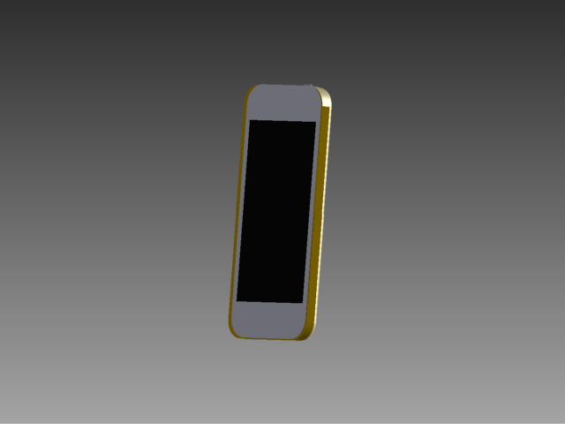
Prototype
Side Angle
Front View
Side Angle

Slide 9
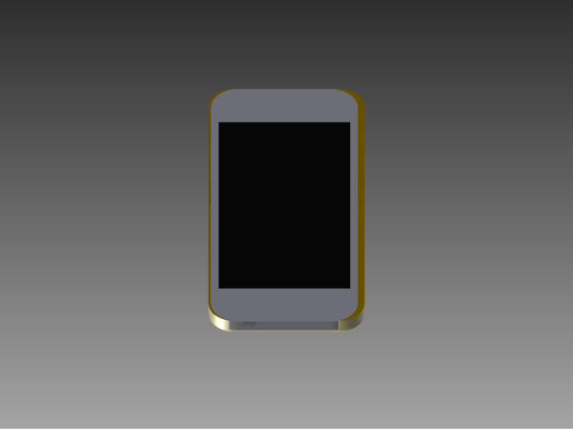
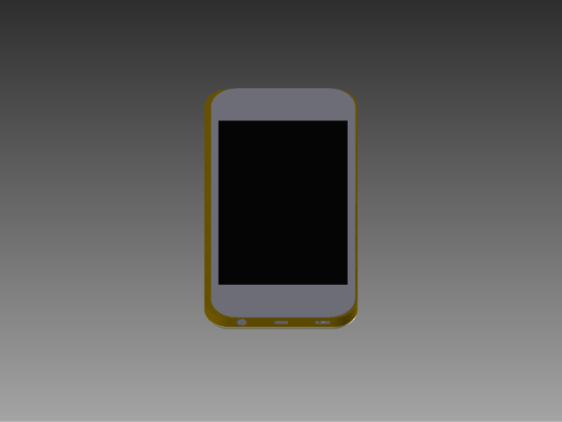
Prototype (cont)
Back View
Top and Front
Bottom and Front

Slide 10
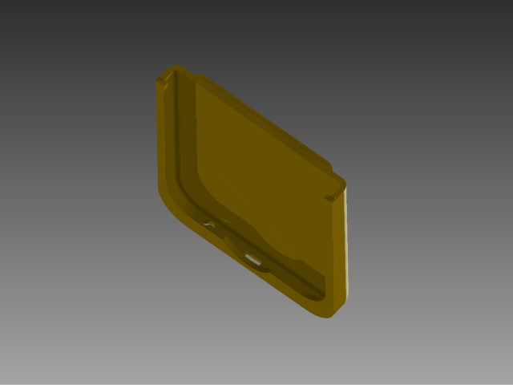
Refine
Bottom of Case
Top of Case

Slide 11
Solution
Case and Phone

Slide 12
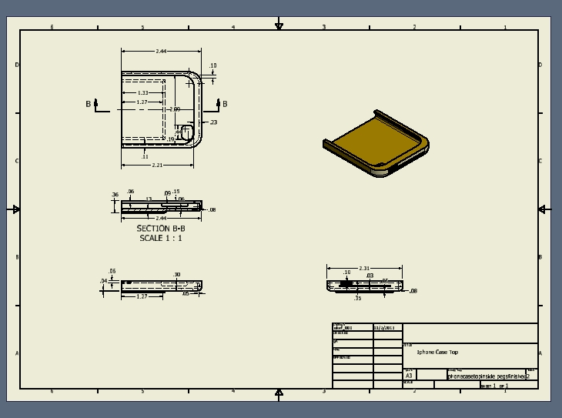
Solution
Top of Case drawings
Bottom of Case drawings

Slide 13
Solution
Drawing of Case and Dummy phone

