Slide 1
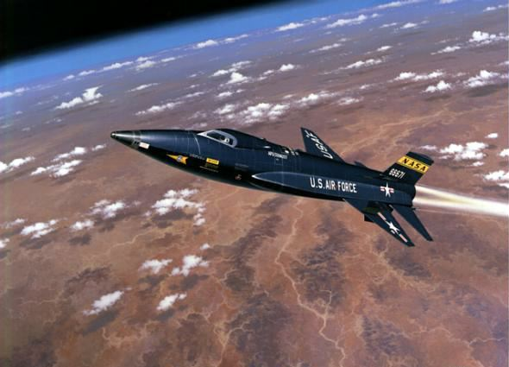
Aerospace Engineering
By: Luke Fickenworth

Slide 2
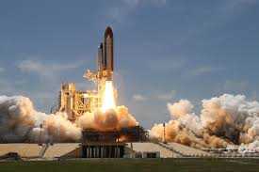
Topics
Education and certification required and salary
Job Description
Field of aerospace engineering and future opportunities
Lockheed Martin
ATK
Sam Williams
Hellmuth Walter
Bibliography

Slide 3
Education and Certification Required and Salary
Most people need a bachelor’s degree to enter in the field
Entry level engineers are not required to be certified, but more experienced engineers must be licensed as professional engineers (PE)
Median pay in 2010 was $97,480 a year and $46.86 an hour

Slide 4
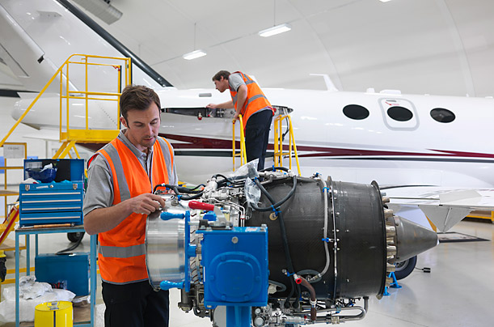
Job Description
Aerospace engineers design airplanes, spacecraft, satellites, and missiles
They test prototypes to make sure they work as they were designed
Aerospace engineers develop new technologies for aviation, defense systems, and spacecraft
Career Profile of an Aerospace Engineer
Average day of Aerospace Engineer

Slide 5
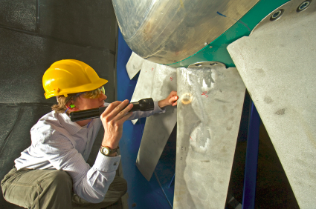
Field of Aerospace Engineering
In 2010, there were 81,000 aerospace engineering jobs in the United States
The 5% growth rate is slower than other fields of work
Some jobs require national security level clearance which will help keep jobs in the country
Demand for more fuel efficient aircraft will provide a need for aerospace engineers

Slide 6
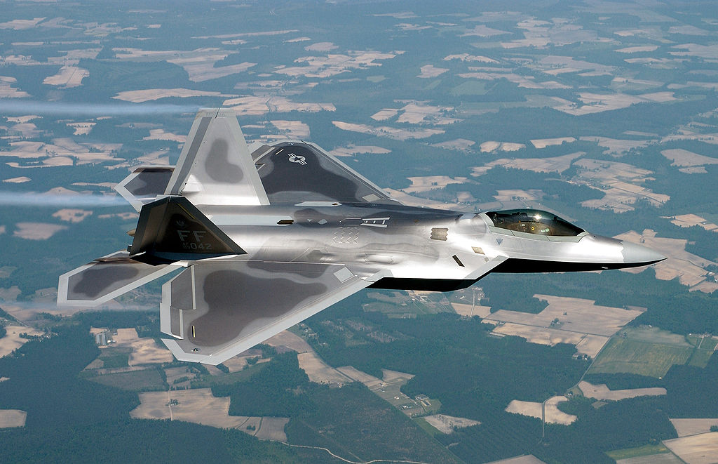
F-22
Lockheed Martin is a global security and aerospace company involved in every step of creating and maintaining products
Their main customers are agencies of the USA government- US Army, Navy, and Air Force
Several of their current aircraft products include the C-141, F-16, and the F-22
They also make products in many other fields, including ground vehicles, missiles, and missile defense
Link: http://www.lockheedmartin.com/us/what-we-do/aerospace-defense.html

Slide 7
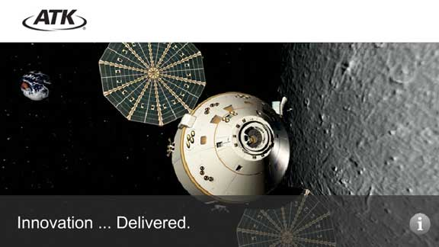
ATK stands for Alliant Techsystems, which is a company which makes and develops products in the markets of aerospace, defense, and sporting
Their products are more of the small details on bigger ideas, such as antennas for stealth fighters and other tactical aircraft
However they also make bigger products, such as small satellites, with four series- A100,200,500,700
Link:http://www.atk.com/product-media-alpha-listing/?order=gro&lt=A

Slide 8
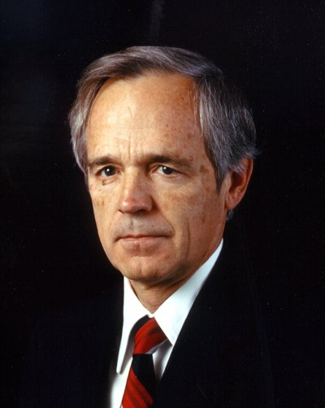
Sam Williams
Sam Williams was an engineer who never worked for big company, but developed all of his products with private funding on his own
Sam helped develop a Navy turboprop and the automotive gas turbine while with Chrysler
He invented the small gas turbine on his own which helped to later make the cruise missile and affordable business jet aircraft
He received the Collier and Wright Memorial trophies as well as the National Medal of Technology

Slide 9
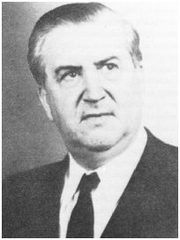
Hellmuth Walter
Hellmuth Walter was a German engineer who lived and invented during the 1930s and 1940s
Came up with the ideas for rocket engines, which got better as WWII went on, and was used in the German fighter, the Messerschmitt Me 163
Also used his knowledge in developing submarines, and launching systems for missiles
Published over 200 patents, and received numerous scientific awards and medals during his life

Slide 10
Bibliography
"Alliant Techsystems Inc." ATK. N.p., n.d. Web. 27 Aug. 2013.
"The Hellmuth Walter Rocket Motor Web Site." The Hellmuth Walter Rocket Motor Web Site. N.p., n.d. Web. 27 Aug. 2013.
"Lockheed Martin Corporation." News. N.p., 27 Aug. 2013. Web. 27 Aug. 2013.
"Make a Donation." National Aviation Hall of Fame. N.p., n.d. Web. 27 Aug. 2013.
"Mentoring Makes a Difference." Lockheed Martin · Products. N.p., n.d. Web. 27 Aug. 2013.
"Summary." U.S. Bureau of Labor Statistics. U.S. Bureau of Labor Statistics, n.d. Web. 27 Aug. 2013.

