Slide 1
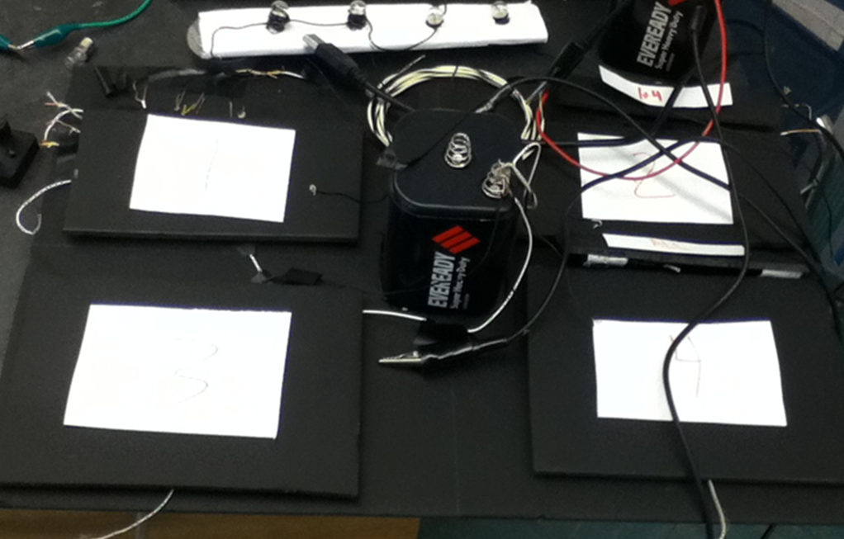
Dance Pad Mania

Slide 2
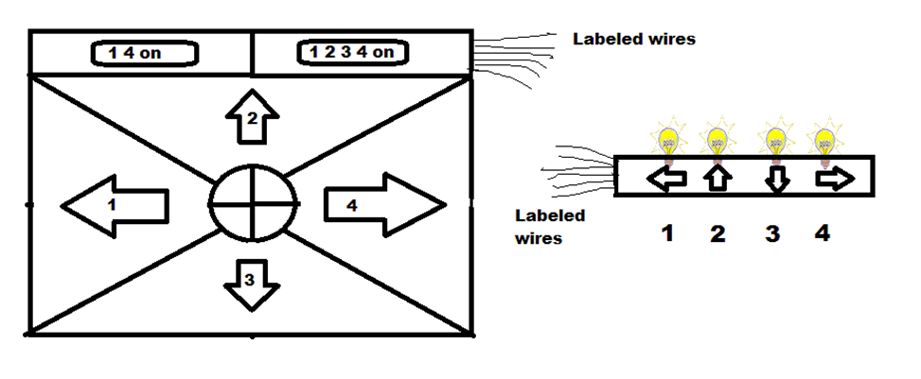
Understand
Our challenge was to build a ¼ scale (11x17 inches) dance pad that students step on to flash a light according to specifications and following materials list
• 6V Lantern Battery
• Aluminum foil
• four light bulbs
• 2 11 x 17-inch sheets of corrugated cardboard
(recommended→get your own)
• Duct tape
• Electrical wire (22-gauge works well)
• Plastic wrap
• Scissors
• Wire strippers

Slide 3
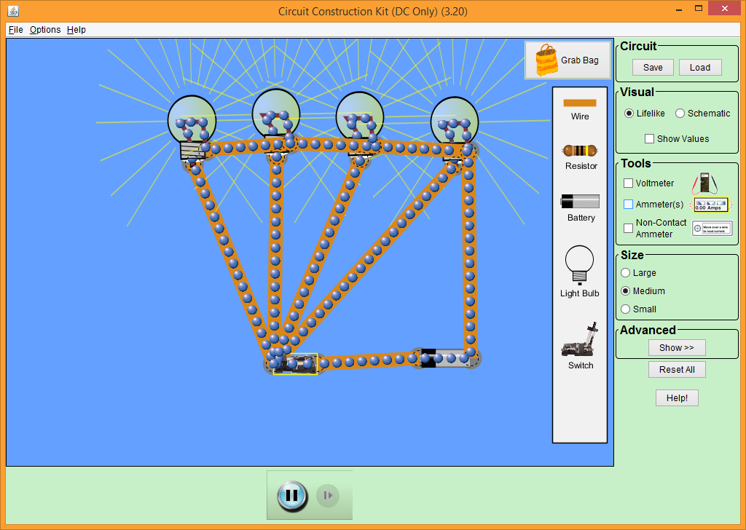
Explore
We brainstormed some ideas of how we can make everything connect and work
We were debating on whether to use a common ground or not, and we decided it would be best for our project
We used the site phet.Colorado.edu and the circuit simulator to test our idea and make sure it would work

Slide 4
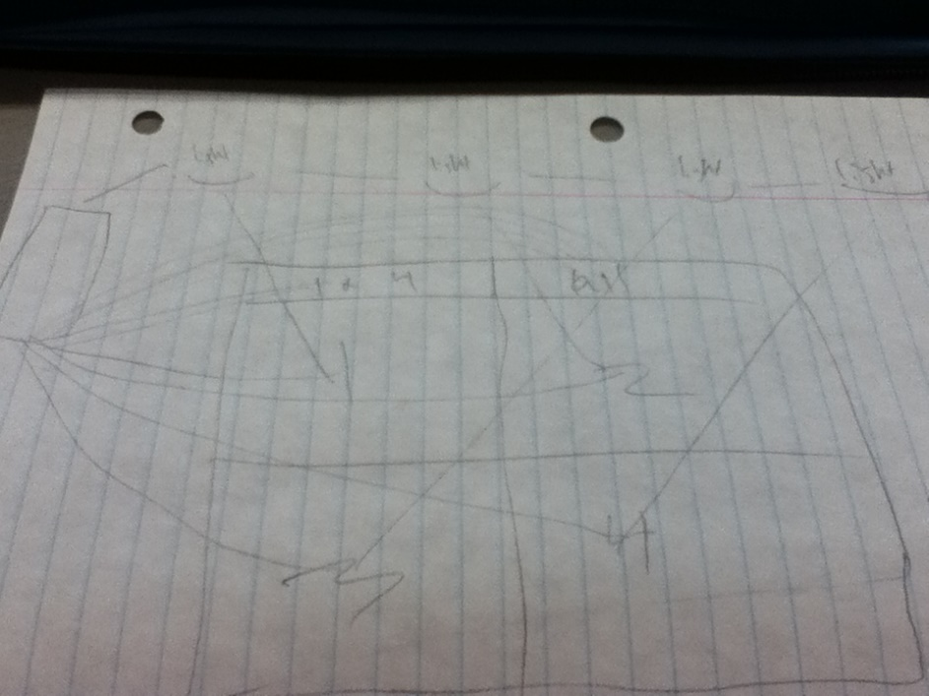
Define
We knew that we needed to have 4 individual lights light up when a pad was pressed on going to each light
We also needed two extra buttons, one which would light up lights 1 and 4, and one button which would light up all 4 lights
We drew a rough sketch of what our project would look like

Slide 5
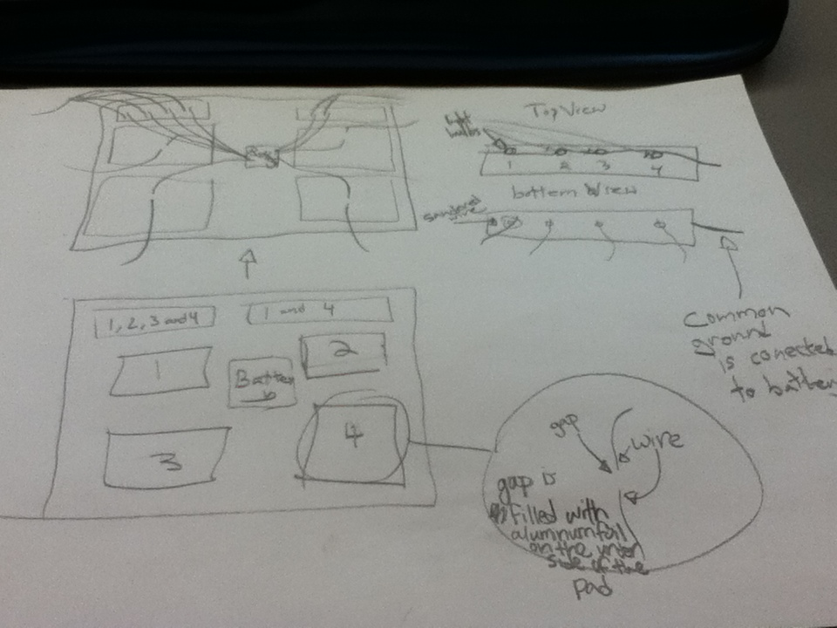
Ideate
This is our final drawing, with the specific wiring shown going through each panel in the dance pad, and how the light station was to be organized with the common ground

Slide 6
Prototype
Our prototypes were constructed with time but we kept the adding to our original prototype rather than creating brand new project
We used the materials that were given to us because that’s what we thought would be easiest, regular light bulbs and the battery that was available
I realized that for the multiple light buttons, I would need individual switches for each wire for it to light up
We went forward with our original idea of the common ground

Slide 7
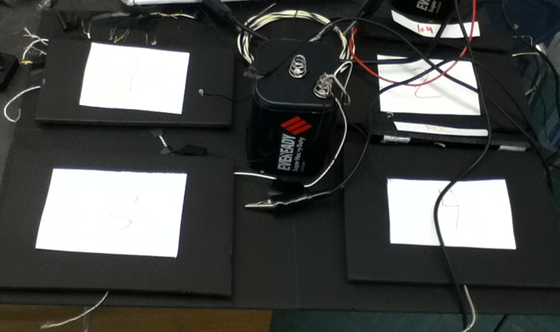
Solution
This was our complete version of the dance pad and the light station. Once put together, the light bulbs would light up corresponding to the dance pad button that was pressed
Light station
Dance pad

Slide 8
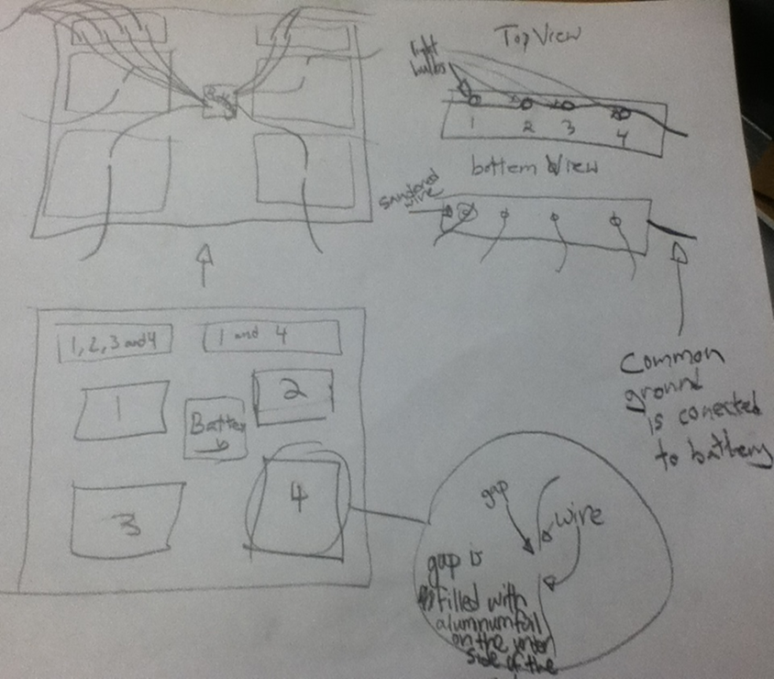
Solution (cont)
Our prototype was designed around the idea of a common wire that would connect to the battery and all of the light bulbs simultaneously. Also our dance pad was to have a wire underneath each pad with a gap in it which could be completed by the aluminum when pressed down
For the 1,2,3,4 button, we had 4 wires connecting to the battery and 4 wires connecting to the according light, with 4 pieces of aluminum foil connecting the circuit. We did the same with the 1 and 4 button, just with 2 of everything

Slide 9
Solution (cont)
Final Product

