Slide 1
Bionic Arm Project
By: Luke Fickenworth

Slide 2
Components
The object of this activity was to build a bionic arm that would pass a series of 4 tests testing its strength, torque, dexterity, and reach. The following list is what I chose to make my arm out of.
Motor- air muscles
Hand- bionic hand
Material- carbon fiber

Slide 3
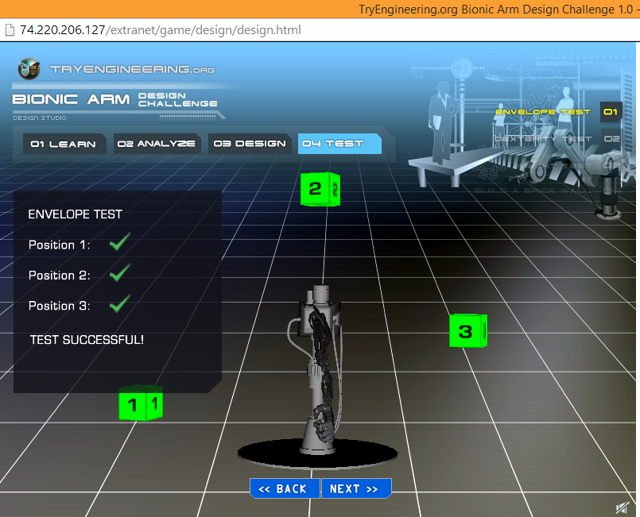
Test #1- Envelope Test
My bionic arm passed this test which tested the dexterity and reach of my arm.

Slide 4
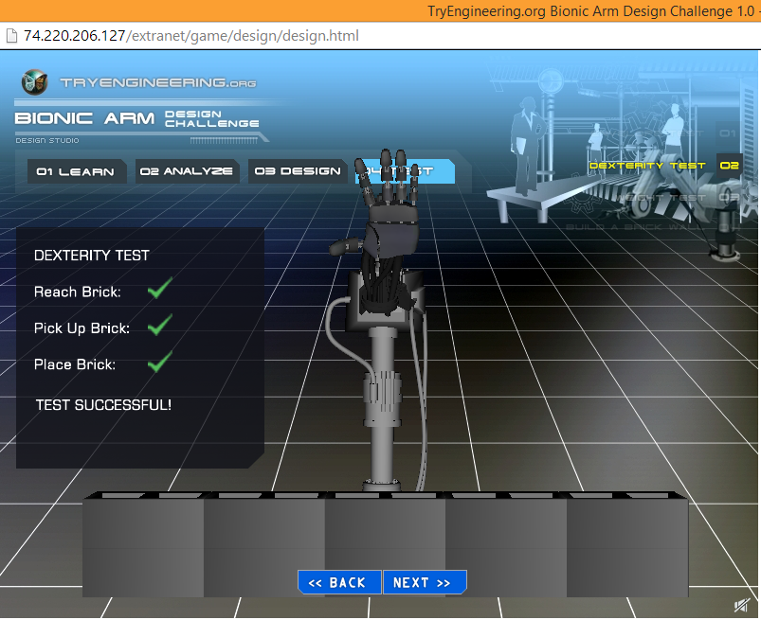
Test #2- Dexterity
This test consisted of reaching down to pick up a brick then placing it into a wall. My arm passed.

Slide 5
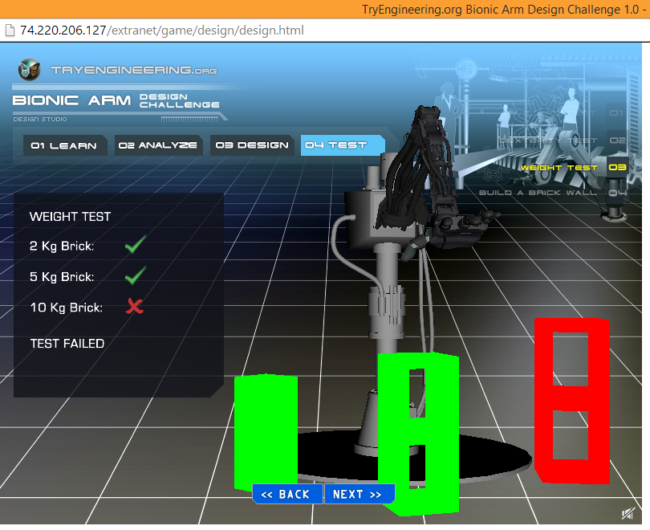
Test #3- Weight
This test measured the strength of my arm. Unfortunately, my arm could only pick up the 2 and 5 Kg brick, not the 10 Kg brick.

Slide 6
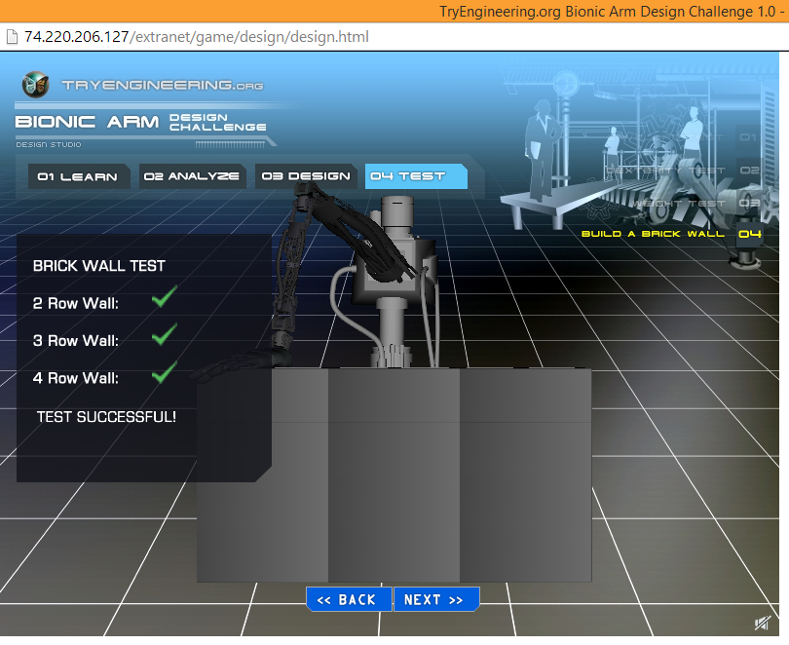
Test #4- Brick Wall Test
This test was the final challenge, with all of the arms factors being tested. The object was to build a 3 by 4 brick wall, which my arm accomplished.

Slide 7
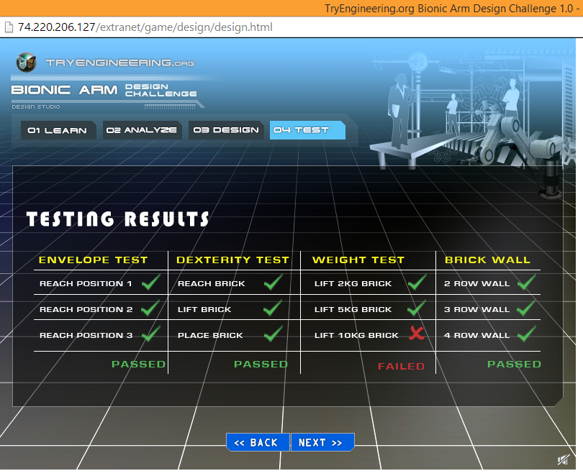
Final Results
My arm passed 3 out of the 4 tests that it was up against. I think it was a successful project.

